Slide 1
Killer Robots & How NOT To Do Data Science
Kate Vang, Christine Henry
DataKind UK

Slide 2
Join poll at slido.com
#8135
Q: When thinking about ethics in data science, what words do you think of?

Slide 3
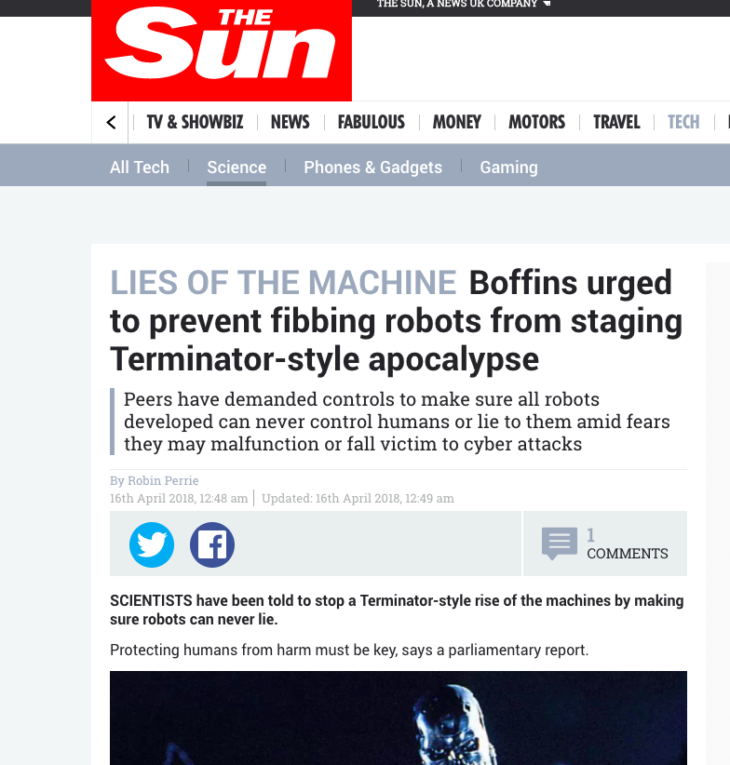
Notes:
Reaction to House of Lords AI report https://www.parliament.uk/ai-committee

Slide 4
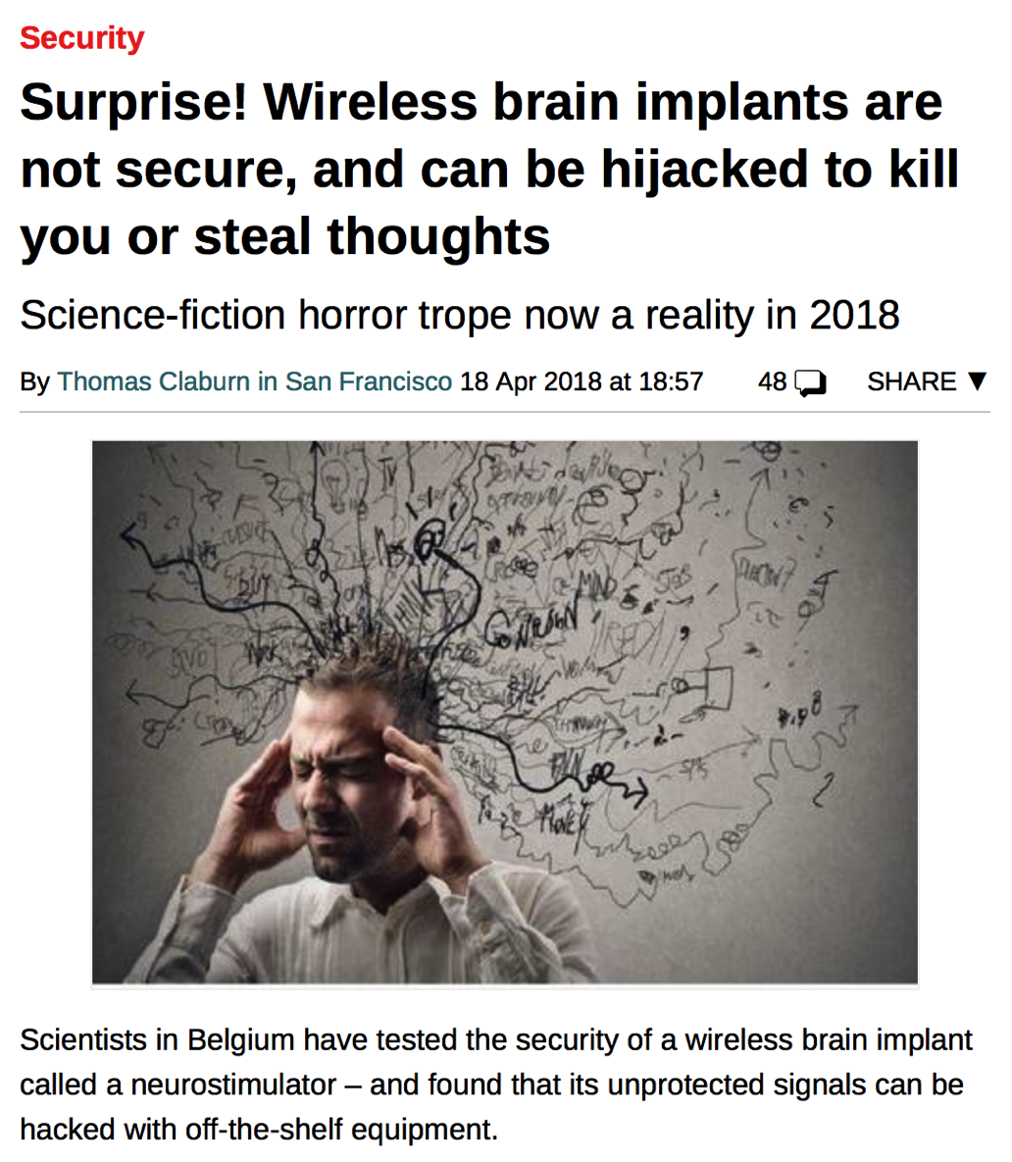
Notes:
https://www.theregister.co.uk/2018/04/18/boffins_break_into_brain_implant/

Slide 5
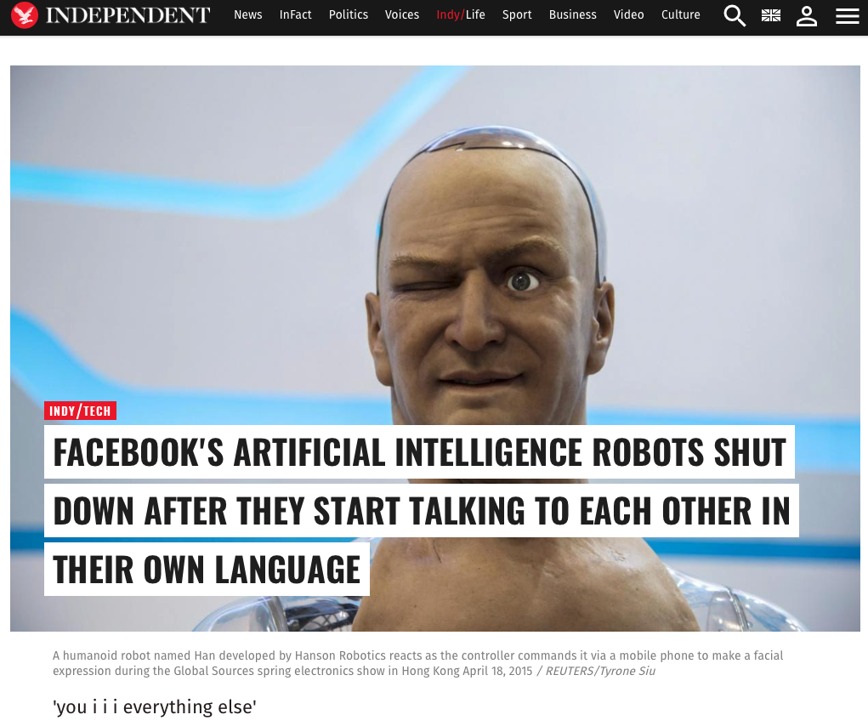
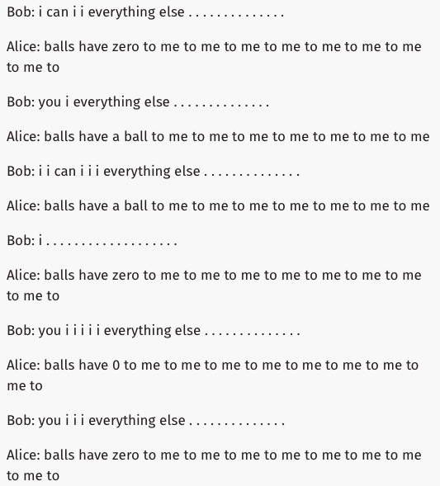
Notes:
In a Facebook research experiment, AI agents in a negotiation swiftly developed a language that only they understood, prompting alarmist headlines. https://www.independent.co.uk/life-style/gadgets-and-tech/news/facebook-artificial-intelligence-ai-chatbot-new-language-research-openai-google-a7869706.html
(The study actually finished as planned: https://www.cnbc.com/2017/08/01/facebook-ai-experiment-did-not-end-because-bots-invented-own-language.html)

Slide 6
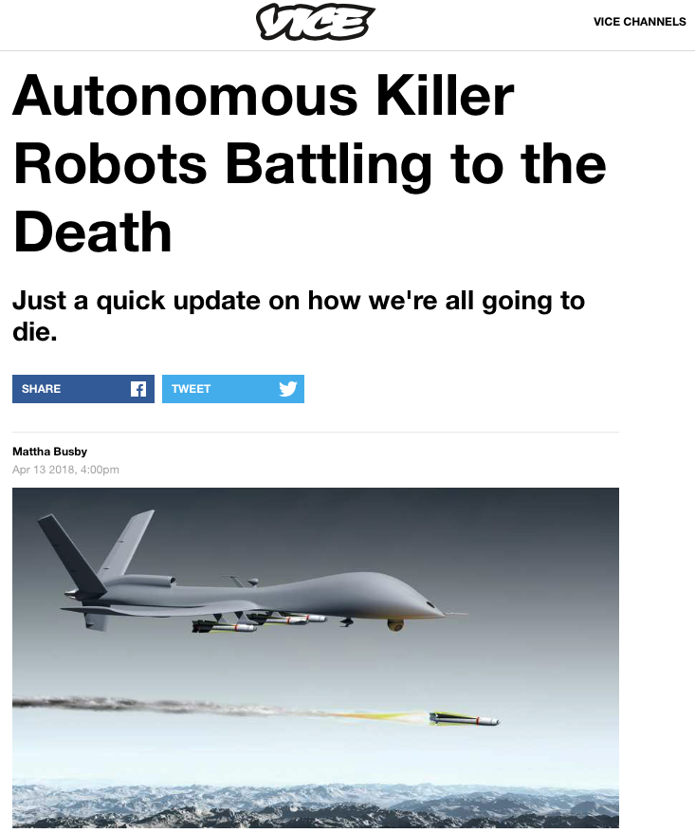
Notes:
https://www.vice.com/en_us/article/evqqy7/the-future-of-war-is-autonomous-killer-robots-battling-to-the-death

Slide 7
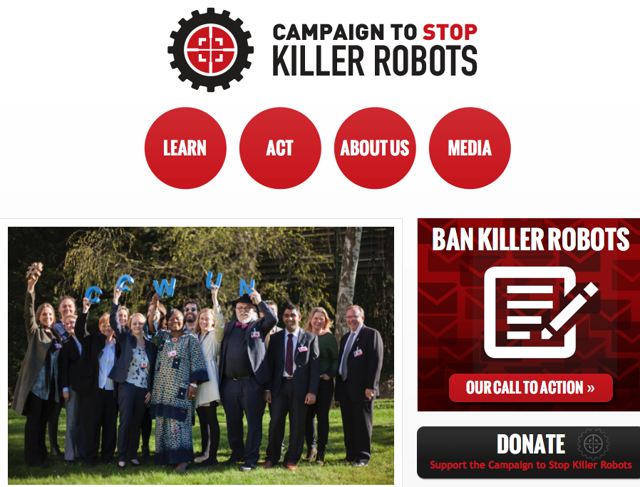

Slide 9
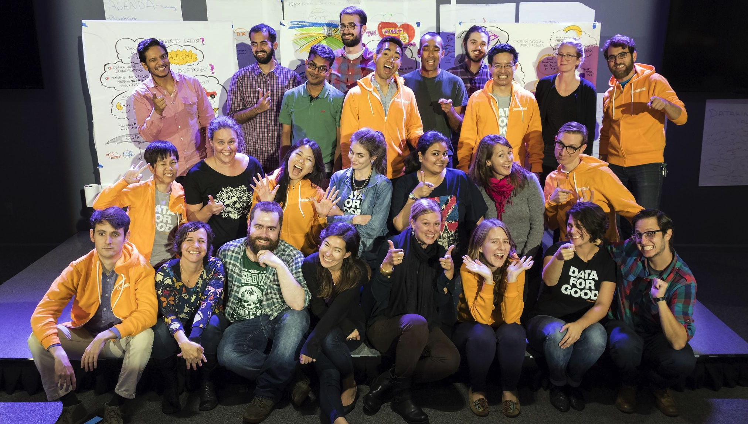

Slide 10
We’ve delivered well over $5 million in pro bono data consulting to social change organizations around the world.
Notes:
We’re headquartered in New York with volunteer-run Chapters doing projects as well in San Francisco, DC, Bangalore, Singapore and the UK.
From helping Amnesty International predict human rights violations to using satellite imagery to help the World Bank estimate poverty to using open city data to help the American Red Cross predict where fires are most likely to occur, we have completed over 70 projects delivering over $5 million in pro bono to organizations worldwide.

Slide 11
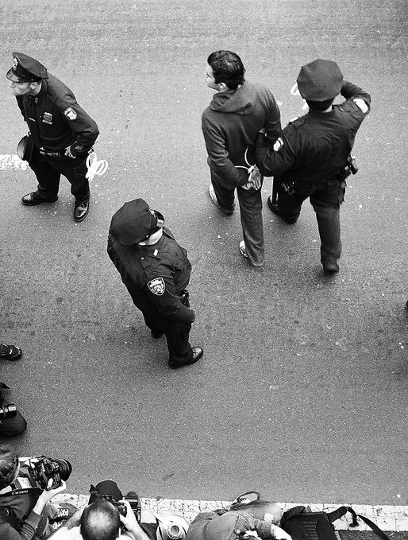
Case Study 1: A US Foundation specialising in social justice wanted to build a predictive model to identify those most likely to reoffend – to prioritise who attends rehabilitation

Slide 12
Join poll at slido.com
#8135
Q: Would you use race/ethnicity as a variable when building this sort of algorithm?

Slide 13
Case Study 1
Cleaning and linking data from multiple sources
Possibility of biased inputs
Possibility of bias-generating models (eg less accurate for minority groups)
No plan to test the predictive model in production

Slide 14
Case Study 1 Learnings
Biased “sensitive” input is often linked with other variables
Communication of model’s limitations crucial - especially around difficulty of productionising
Cleaning and linking data takes longer than you think
(OK…. perhaps we already knew that last one)

Slide 15
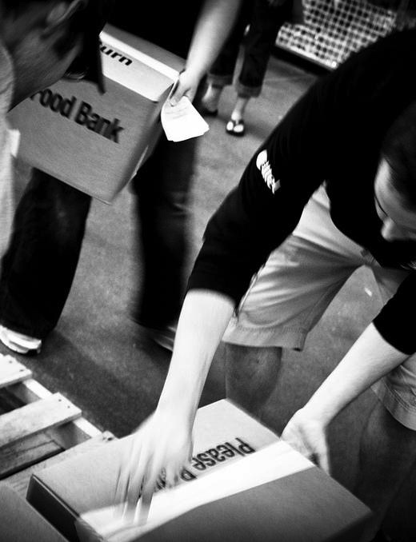
Case Study 2: Create a predictive model for a regional foodbank charity, to identify users who are most likely to need extra support
Notes:
As an example of this, we scoped a project with a national mental health charity.

Slide 16
Join poll at slido.com
#8135
Q: Would you use a random forest if your client know little about data and would have to explain decisions to end users?

Slide 17
Case Study 2
Ethnicity and mental health flagged as key variables
Flagged early enough in process to consult data experts and ethics experts
Charity partners with limited knowledge of data science
Data Corps team chose a Random Forest model
Notes:
As an example of this, we scoped a project with a national mental health charity.

Slide 18
Case Study 2 Learnings
You may surface real differences between groups linked to a sensitive characteristic. That’s OK!
Complex models are more accepted if they produce an (apparently) simple output
Project scope and intent matter
Notes:
As an example of this, we scoped a project with a national mental health charity.

Slide 19
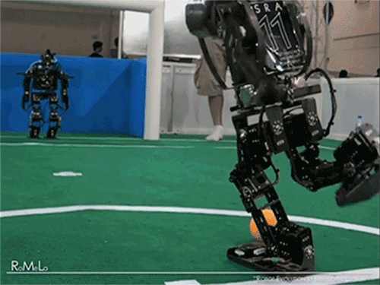
What we are learning...
Notes:
https://giphy.com/gifs/EizPK3InQbrNK/links

Slide 20
Does something make you, or anyone on the team, feel icky? If so, create the space to stop and reflect.
Notes:
https://heinakroon.com/2012/10/20/the-uncanny-valley/

Slide 21
2. Talk to people. Can the client explain why the model depends on a sensitive variable?
Notes:
https://paul-baxter.blogspot.co.uk/p/research-details.html

Slide 22
3. Think about explainability. Will your clients be able to understand the model AND explain decisions to end users?

Slide 23
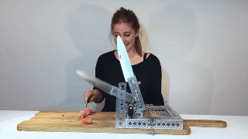
4. Project intent matters. But also consider the unintended impacts.

Slide 24
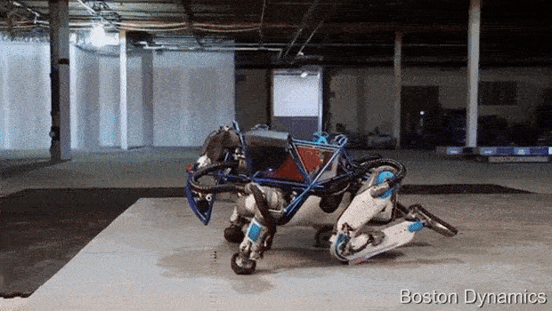
Some ethics starting points...
Notes:
https://spectrum.ieee.org/automaton/robotics/humanoids/next-generation-of-boston-dynamics-atlas-robot/

Slide 25
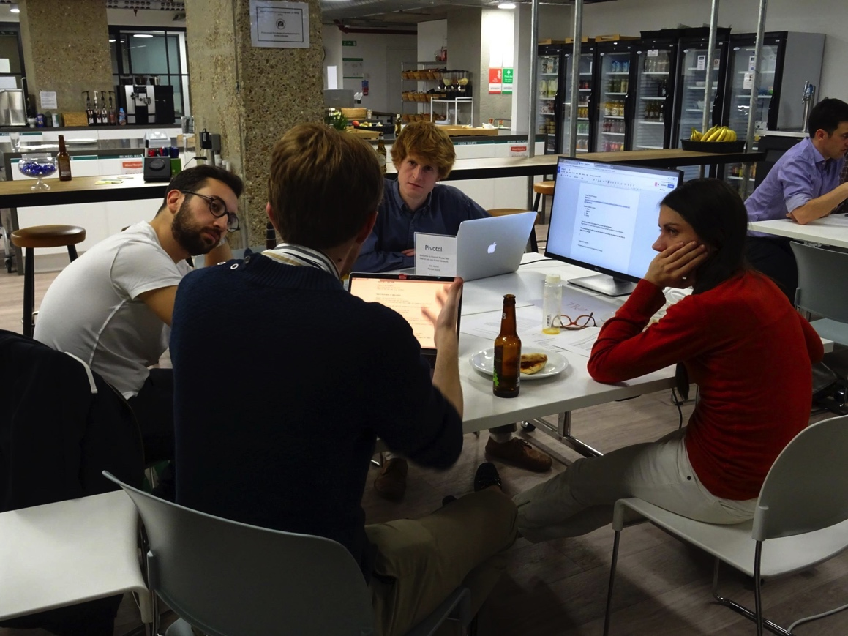
DataKind UK volunteer ethics principles
http://www.datakind.org/blog/doing-data-for-good-right

Slide 26
Data Ethics Canvas
https://theodi.org/article/data-ethics-canvas/

Slide 27
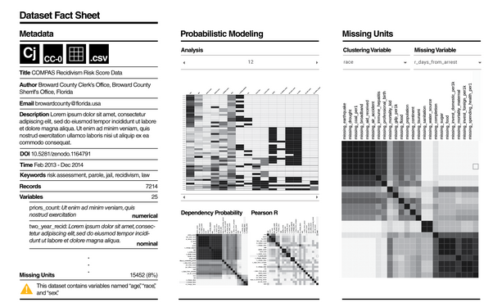
Data Nutrition Labels
http://datanutrition.media.mit.edu/
Or also Datasheets for Datasets https://arxiv.org/pdf/1803.09010.pdf
Notes:
see also Datasheets for Datasets https://arxiv.org/pdf/1803.09010.pdf

Slide 28
Volunteer with DataKind!
@DataKindUK
http://www.datakind.org.uk/

Slide 29
Questions?
Examples?
Ethical quandaries?

